Slide 1
Kevin Pottie MD, CCFP, MClSc FCFP Associate Professor, Departments of Family Medicine and Epidemiology and Community Medicine, University of Ottawa Institute of Population Health and CT Lamont Centre for Research on Primary Health Care on behalf of the Canadian Collaboration for Immigrant and Refugee Health
Knowledge Translation to Improve the Health of Vulnerable Populations

Slide 2
Science is both a collection of ideological beliefs and an agency for liberation, it substitutes democracy for political and religious authority.
Demanding evidence for statements and providing criteria to test the evidence, it gives us a way to distinguish between what is true and what powerful people might wish to convince us is true.
Tesh SN 1989
Notes:
Power and Knowledge
Setting the Context

Slide 3
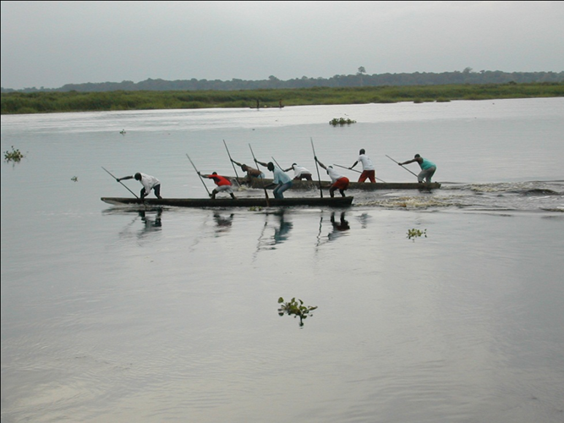
Presentation Objectives
To describe how equity and GRADE approach were used to develop clinical guidelines for immigrants and refugees
To give examples of emerging KT implementation tools and strategies for CCIRH guidelines
To compare and contrast KT to improve the health of vulnerable populations with KT strategies for general population

Slide 4
How easily interventions lose traction
From Efficacy to Effective Coverage
Efficacy
20%
X Access
X 80%
Health System Factors
X Targeting Accuracy
X 80%
X Provider Compliance
X 75%
X Consumer Adherence
X 75%
Averages mask inequities
Don de Savigny
= Effectiveness
= 7%
Notes:
This slide is from Don deSavigny

Slide 5
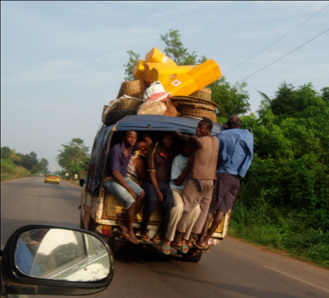
CCIRH Objective
To develop evidence-based clinical preventive guidelines for immigrants and refugees new to Canada (focus on first 5 years) for primary care practitioners

Slide 6
What are the health problems?
Why does it occur (risk factors)?
Is it important?
How do immigrants and refugees differ from the Canadian population?
What actions might be most feasible for primary care practitioners ?
Is it useful for practitioners?
Does doing this cost more than that?
Will practitioners use it?
If I do this here what happens over there?
Will immigrants accept it?

Slide 7
GRADE: CCIRH/TF Guidelines
Two components of GRADE:
Quality of Evidence (confidence in estimate of effects)
high, moderate, low, very low
Strength of Recommendation
strong and weak

Slide 8
GRADE Determinants of confidence
RCTs start high; Observational studies start low
5 limitations can lower confidence
Bias (concealment, blinding, loss to follow-up)
Inconsistency (variability in results, heterogeneity)
Indirectness
Imprecision (wide confidence intervals)
Publication bias
3 strengths can raise confidence
Large magnitude of effect (RR>5/<0.2)
Dose-response gradient
Plausible confounders strengthen association

Slide 9
Cochrane Equity Lens
Baseline Risk for Population
Culture, Diet, Genetic Differences
Practitioner adherence
Patient adherence

Slide 10
CMAJ Evidence Based Clinical Guidelines for Immigrants and Refugees
Infectious Diseases
MMR/DPTP-HIB
Varicella (Chicken Pox)
Hepatitis B*
Tuberculosis*
HIV/ AIDS*
Hepatitis C
Intestinal Parasites*
Malaria
Mental Health and Maltreatment
Depression *
Post Traumatic Stress Disorder*
Child Maltreatment*
Intimate Partner Violence *
Other Chronic Disease
Diabetes*
Dental disease*
Contraception
Cervical Cervix/HPV
Iron Deficiency Anemia*
Vision Disorders
Pregnancy Care
Pottie K, Greenaway C, Feightner J, et al . Evidence Based Clinical Guidelines for Immigrants and Refugees. CMAJ 2011
Notes:
The ones with asterisk are the ones that had 80% consensus after one round
Note the prominence of mental health concerns, but also dental made it into top 11
The list of top 20 conditions was reviewed and approved by the expert panel at the consensus conference: with one modification by the panel of key experts who would be developing the guidelines: Routine vaccine preventable diseases were considered a single priority, combining tetanus diphtheria and polio with MMR for guideline development.
Third round - As a final step, Delphi participants were sent the identified 20 conditions for approval and discussion; of the 41 participants, 88% approved (35/35 who participated in this round).

Slide 11
Migrant System Support Needs
Promote knowledge to migrants about health system and services and their entitlements
Overcome language barriers
Improve integration of health care with social services, including appropriate training and education
Dissemination of evidence based recommendations to support practitioners address migrant health

Slide 12
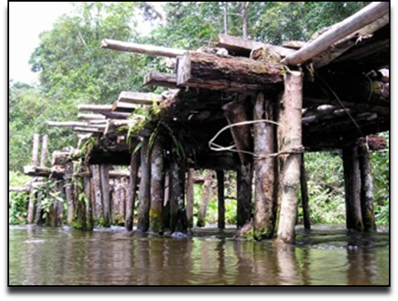
Knowledge Exchange Network
Practitioners/Students
Community Leaders/Immigrants
Policymakers
Network of Networks
www.ccirhken.ca

Slide 13
Global Health Education Frameworks
CANMeds for
Global Health
Redwood-Campbell et al 2010

Slide 14
Refugees and Global Health E-Learning
Developing Global Health Competencies for medical and health professional students
Eight modules based on CANMEDS competencies
Available at www.ccirhken.ca

Slide 15
Cochrane CCIRH Podcasts
http://dev.test.cochrane.org/podcasts/issue/Immigrant%20Health/575
Series of Narrative-Based Podcasts for Practitioners

Slide 16
CHECKLIST Web App
CCIRH PREVENTIVE CARE CHECKLIST FOR NEW IMMIGRANTS AND REFUGEES
Integrating CCIRH and TF GRADE recommendations, podcasts, and e-learning into web-enhanced Rourke-style checklist for family physicians

Slide 17
CIHR Jit/Jat TelehealthTeam
Address access/communication barriers
Improve evidence based decision support (integrate evidence based guidelines)
Promote Telehealth as resource for recent immigrants
Enhance telehealth services with support from our immigrant community leaders
Link Telehealth with local health services and settlement services
Notes:
Delphi results

Slide 19
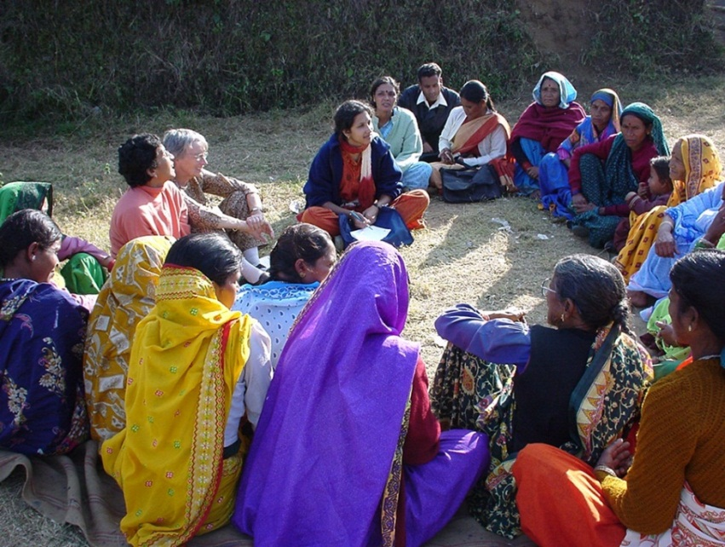
Thank you!

