Slide 1
Teams Advancing Patient Experiences: Strengthening Quality
Lisa Dolovich
Department of Family Medicine
McMaster University
On behalf of the TAPESTRY team

Slide 2
Outline
Describe the
  TAPESTRY organization
  TAPESTRY approach
  TAPESTRY program development
  TAPESTRY selected research findings and next step research plans

Slide 3
TAPESTRY Support
A Health Canada funded initiative ($6.5 m)
    with additional support from the Government of Ontario (MOHLTC)
    LaBarge Optimal Aging Initiative
    McMaster Family Health Organization
2013-2016
Funding awarded to the Faculty of Health Sciences, McMaster University
($2.0 m)

Slide 4
TAPESTRY Leads www.healthtapestry.ca
Co-Principal Investigators
Lisa Dolovich, BScPhm Pharm D, MSc
Doug Oliver, MSc MD CCFP
David Price, MD CCFP FCFP
Co-Investigators (Ontario)
Gina Agarwal
Tracey Carr
David Chan
Ron Goeree
Lauren Griffith
Monika Kastner
Linda Lee
Lori Letts
Dee Mangin
Mark Oremus
Alex Papaioannou
Jenny Ploeg
Janet Pritchard
Parminder Raina
Julie Richardson
Cathy Risdon
Sharon Straus
Ruta Valaitis

Slide 5

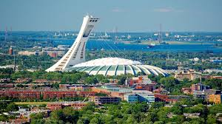



Partner Sites
Vancouver, BC Drs John Sloan, Margaret McGregor, Jay Slater, Johanna Trimble Population: Inner city, home-bound frail elderly | Montreal, QC Dr Mark Roper and colleagues from McGill University Population: New immigrant patient population
Saskatoon / Sturgeon Lake First Nation, SK Dr Vivian Ramsden, Ms Shirley Bighead, Ms Norma Rabbitskin Population: Aboriginal health with diabetes focus | Newfoundland/ Alberta Drs Kris Aubrey (Memorial University), and Donna Manca (University of Alberta) Population: community-based, rural
By Training Volunteers to serve as a link between the primary care team and the patient’s home.
By Using Technology from the home to link directly with the primary health care team
      iPads with TAPESTRY APP for volunteers to use
      The Personal Health Record (PHR) – McMaster PHR
      Innovative resources (ie; Optimal Aging Portal)

Slide 6
TAPESRY is pursuing the goal of promoting optimal aging in Canada
Through intentional, proactive conversations about patient health and life goals within the primary healthcare setting
Through improved connections between interprofessional primary care providers/teams, community service providers and informal caregivers

Slide 7
TAPESTRY Approach
(a multicomponent, interconnected complex intervention)
People in their Homes
Trained Volunteers
Information Technology
Community Engagement
Inter-professional Teams/System Navigation
To foster optimal aging for people living at home using an interprofessional primary health care team delivery approach that centres on meeting a person’s health goals.
Many aspects of KT woven throughout

Slide 8
Intervention Description -1 (linear)
Volunteers managed by a partner community organization receive in-person training, as well as OSCE experience; ongoing lunch and learn sessions
Patients / families receive visits from volunteer pairs in their homes
Volunteers:
  gather information using structured tools including the TAP What Matters To Me (GOALs) App and complete a narrative report on the TAP-APP on a tablet computer
  provide support to initiate, educate or use the McMaster Personal Health Record, Optimal Aging Portal
  build relationship with patient as extension of healthcare team

Slide 9
Intervention Description -2 (linear)
Report summarizing information into a TAP-report with alerts manually generated by program staff and faxed to clinic (MRP)*
Report discussed at clinic ‘intake’ meetings with 3-4 designated people that include the volunteer coordinator and system navigator
Team responds to alerts on TAP-report to create and document a management plan focused on
  Actions for primary care providers
  Actions for next volunteer encounters
  Actions to use the PHR (including APPs)**
  Actions to link to community agencies
Cycles repeats (and is augmented)
* Automated Jan 2015; **specific APPs in development

Slide 10
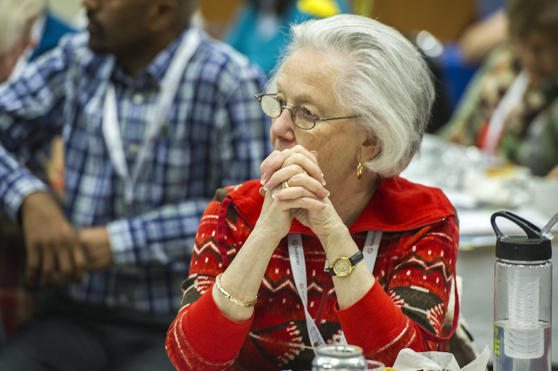


The TAPESTRY volunteer Program
Expanding the Team, Engaging the Community.
(Lead: Oliver)

Slide 11

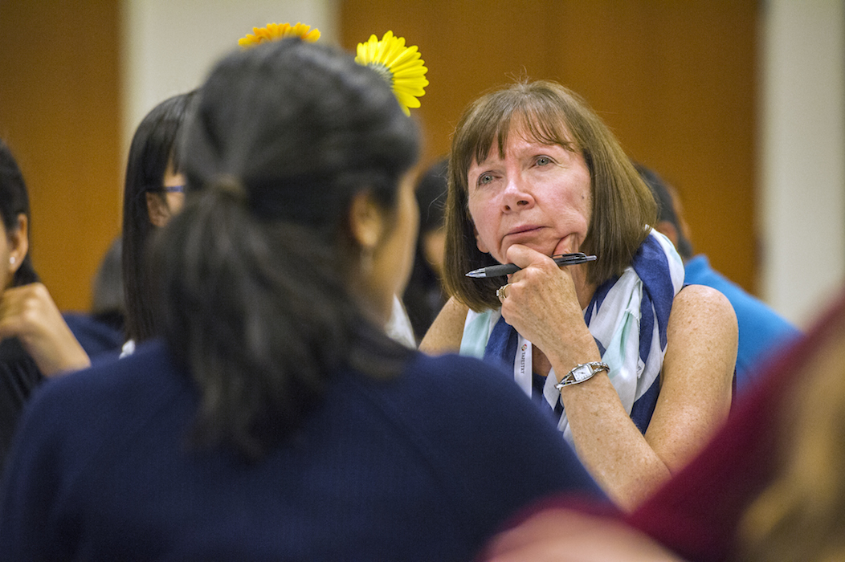
Who are the Volunteers?
Student Volunteer
Experienced Volunteer

Slide 12
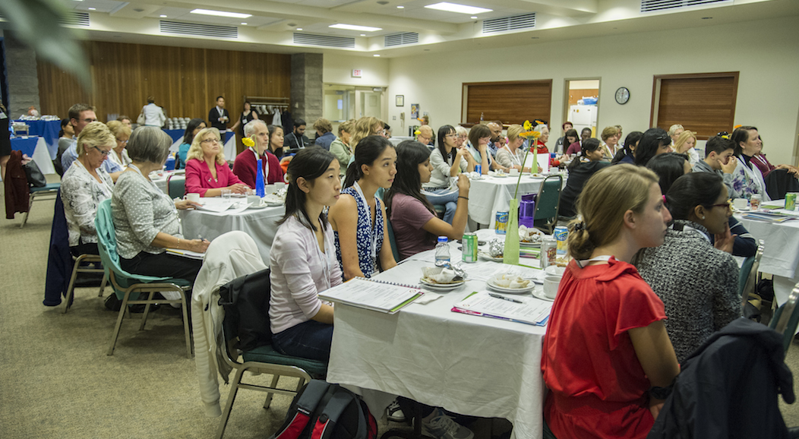
How are they Prepared?
Application & Interview
Immunizations Updated
Police Check
On-Line Learning Centre
In Person Program Welcome
Regular Lunch and Learn Sessions

Slide 13
Technology
The McMaster PHR, Virtual Learning Centre and the TAP APP
(Leads: Chan, Carr, Agarwal, Richardson, Letts)

Slide 14
The Virtual Learning Centre for volunteers and clinicians
Interactive
    Video scenarios
    Voice over content presentations
    Volunteer messaging forum
    Tests of proficiency
Adaptable
    Content easily added, taken out and edited based on the needs of each community
Sustainable
    Available free to each site
    No need for live training sessions

Slide 15
The McMaster PHR
Functions
Record of Health Data
Improved Communication with Primary Care Team
Book on-line Appointments
Access Medical Records
Utilize Self Management Tools for DM, HTN, Exercise, Nutrition and other health goals.

Slide 16
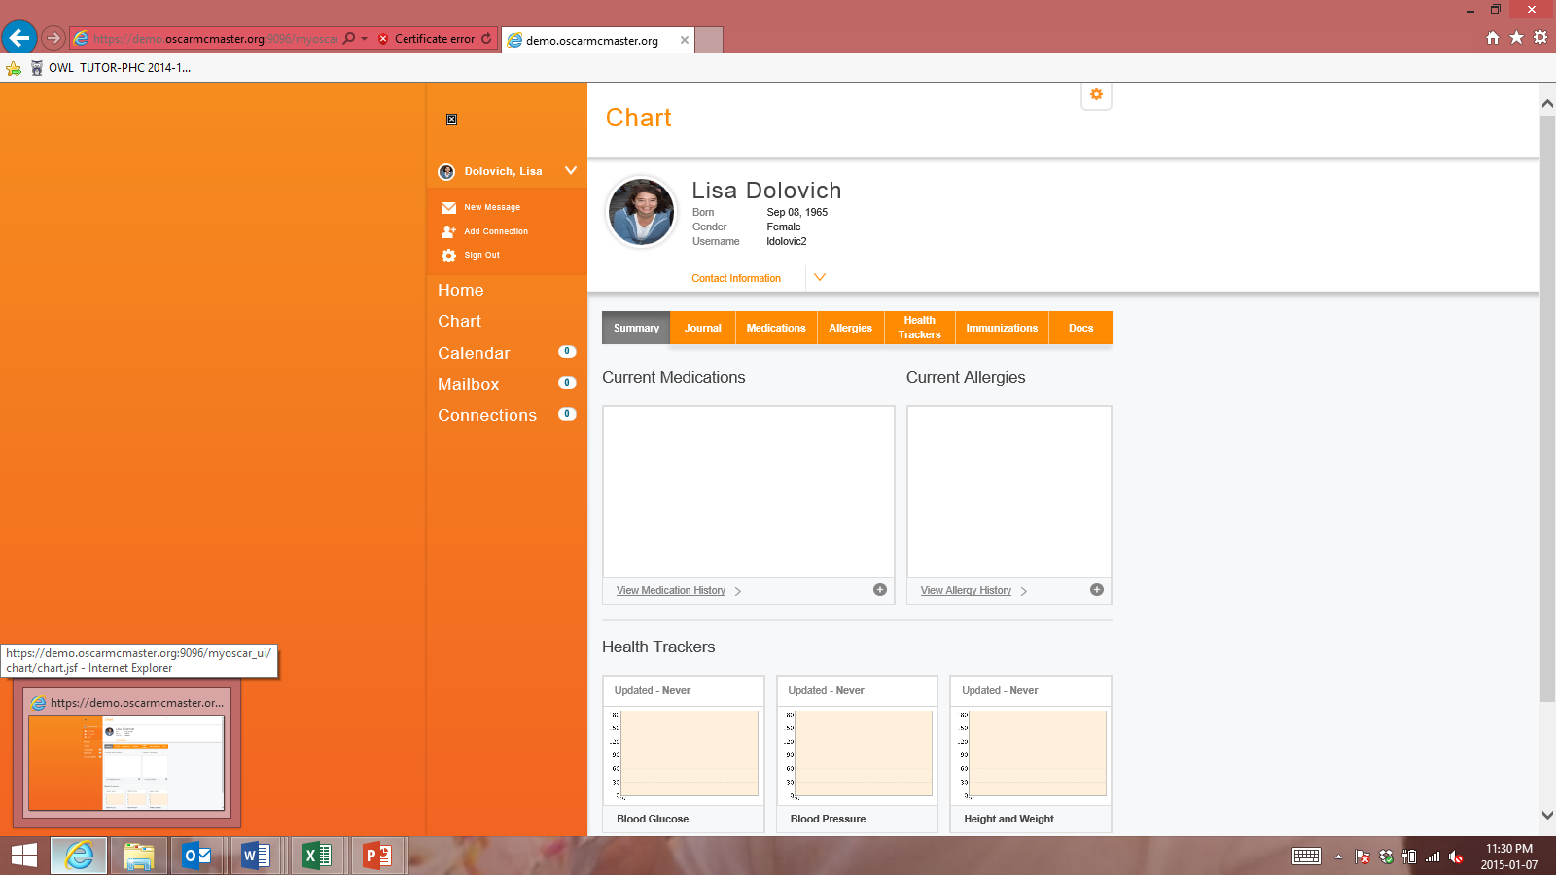
McMaster PHR

Slide 17
The TAPESTRY APP
Introductory Tools – Visit 1.
  Goal Setting Exercise
  What Matters Most? Who Matters Most?
Tools Related to Optimal Aging – Visit 2, 3 and beyond.
  Nutrition (Screen II)
  Physical Activity (RAPA) and Mobility (Manty)
  Social Supports (Duke Social Support Index)
  Functional Abilities and overall health (Edmonton Frail Scale, EQ5D)
  Advance Directives
  Cognition and Mental Health

Slide 18
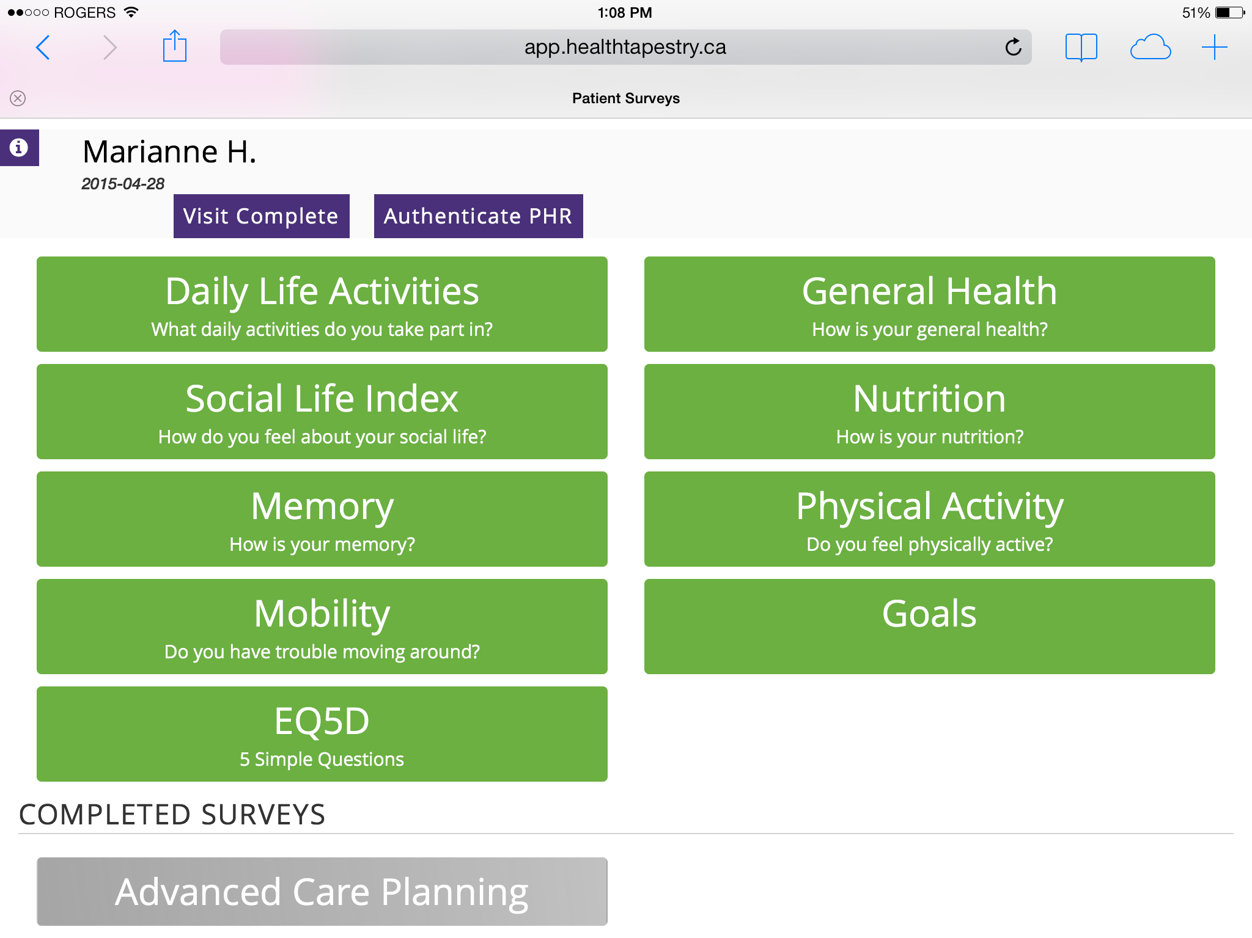

Slide 19
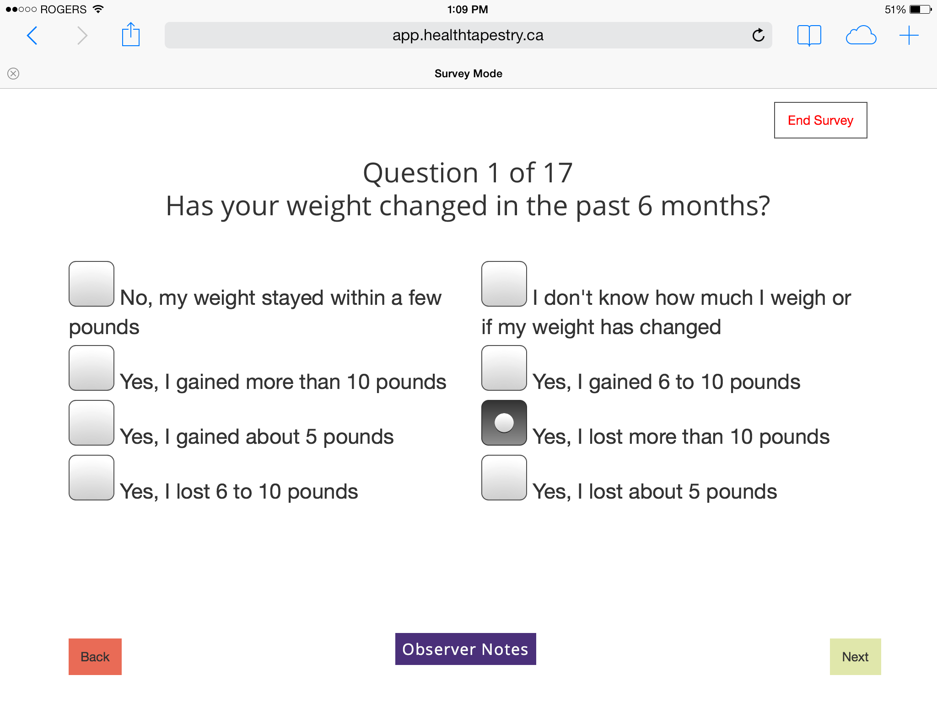

Slide 20
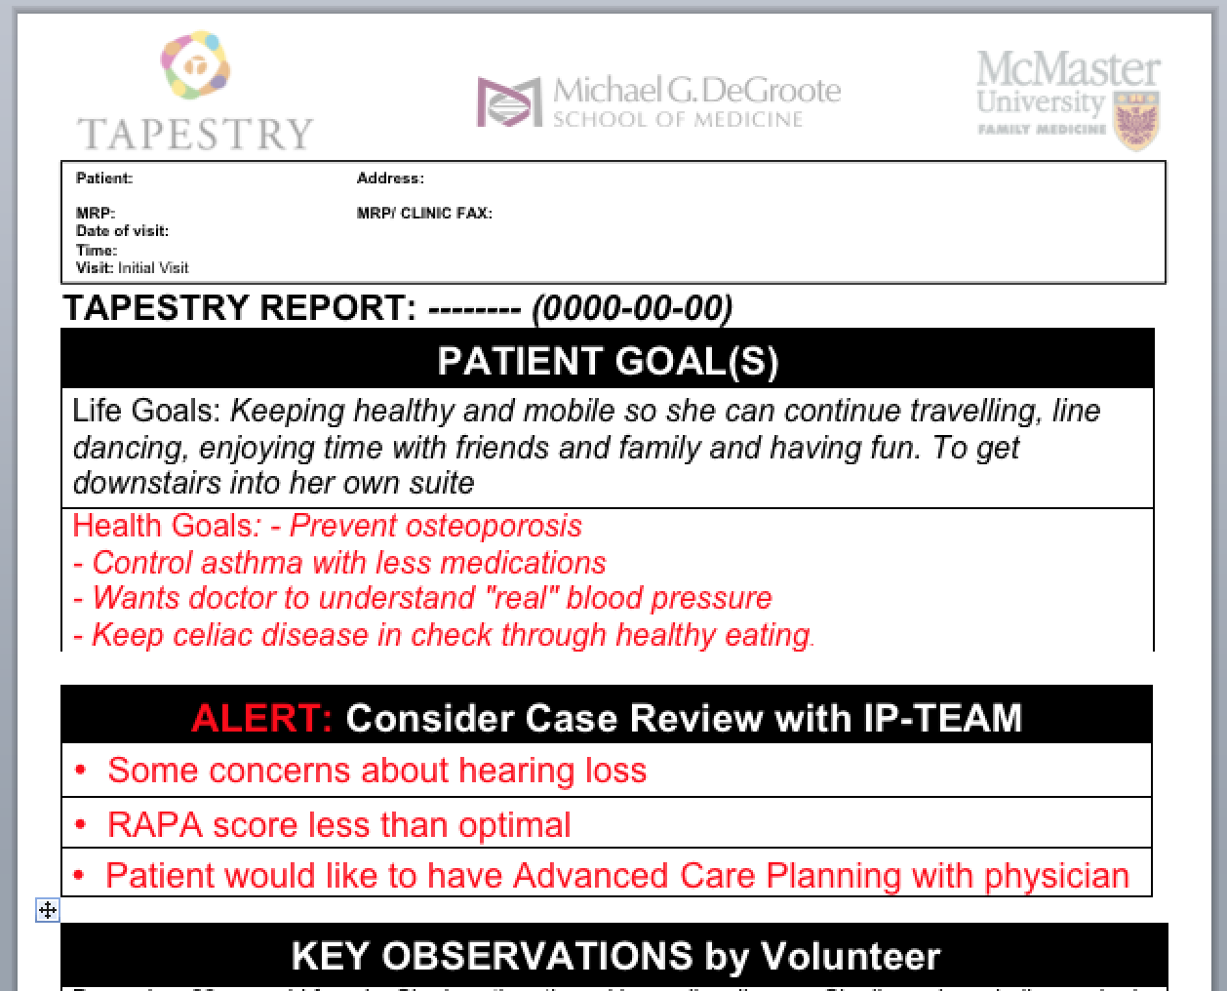

Slide 21
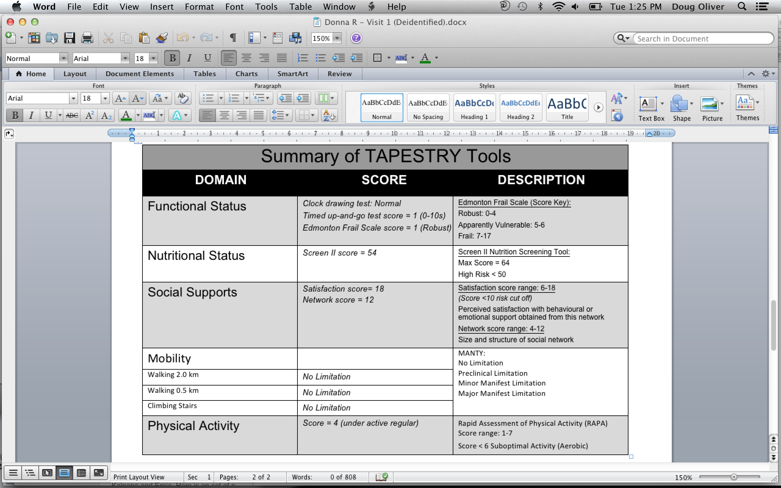

Slide 22
Clinical Teams
What Have Clinics Done to Change How They Work?
    TIME and SPACE: Weekly huddles occur in our clinical settings to review TAP Reports coming in from Volunteers
How are Clinicians Using The Information?
    Care plans developed based on:
      Patient Goals
      Results of Clinical Tools (from the APP)
      The Clinical Teams’ knowledge of the patient.
      Engagement with Community Service Providers
      Volunteers engaged in follow up activities

Slide 23
Community Services
Pilot testing a process for personalizing identification of community services and activities
Community partner agencies participating in program development

Slide 24
Steps to Develop the
TAPESTRY Approach
Co-design using the persona scenario exercise
Formal consideration of sustainability from start
Developmental evaluation approach applied throughout development phase
Iterative pilot testing with Qual and Quan data collection including adaptations
Build to larger scale RCTs

Slide 25
Co-development Design of TAPESTRY using Persona Scenario methodology
(Leads: Valitis and Dolovich)
IT/E-health background
  Characteristic elements: Actors or agents, setting, goals or objectives, actions and events
Adapted for development of complex health services intervention
Advantages over traditional focus group discussion
  Examining a complex concept not yet in place
  Informed by experience yet separated
  Focused communication – developing specifications
Valiatis et. al, Persona-scenario exercise for co-designing primary care interventions Canadian Family Physician, (60) March 2014
Notes:
We held a series of discussion groups with potential end users and providers with goal to have them assist in the development of the project.
Rather than traditional focus groups, decided to use persona scenario methodology as outlined by: Carroll JM. Five reasons for scenario-based design. Interacting with computers 2000; 13:43-60.
Persona Scenarios can be used not to control complexity and fluidity but to exploit it.
Scenarios are stories about people and their activities – highlight goals suggested by the appearance and behavior of the system,
- what people try to do with the system,
what procedures are adopted, not adopted,
- carried out successfully or not
and what interpretations people make of what happens to them.
Include settings, agents or actors, goals or objectives, actions and events –changes things
As Carroll eloquently put it persona scenarios provide “multiple views of an interaction with diverse kinds and amounts of detail”

Slide 26
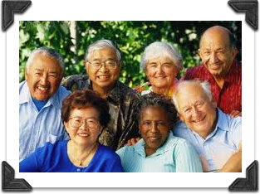
Participants (in groups)
53 participants
including:
  Patients
  Volunteers
  Interprofessional health care team members
  Service providers from community organizations
Notes:
As part of co-design of sister project, 70 participants (volunteers, community service providers, healthcare team and solo practitioners, as well as patients from multiple SEC) were engaged in 14 persona scenario groups
This data was collected and analysis had begun before TAP-CM
Drew experience from these learnings and added 5 additional groups to focus in on key areas critical to TAP CM such as health tracking, self-management
Particularly engaged those working with older adults with diabetes and/or hypertension or offering services to older adults with diabetes and/or hypertension

Slide 27
Data Collection
Discussion Group overview
Standard questions, tailored to audience
Guided by facilitator/assistants
Worked in pairs (mostly)
  Created a persona/scenario based on their background (name, age, comfort with technology, attitudes about health etc…)
Reported answers to recorder
Shared personas and scenarios with group
Also see:
Notes:
We held groups with similar audiences (clinicians with clinicians, etc.).
More detail outlined in our publication

Slide 28

User-Centred Design example:
Persona Scenario Exercise for development of an multicomponent approach to be integrated into the health care system …
Health care team
volunteers
Community organizations
technology
Notes:
How does the patient become involved with TAPESTRY?
What are the following people doing in the scenario? Think about the activities that are taking place as well as communication between each group of people.
Patients
Health care providers
Community service providers
TAPESTRY community volunteers
How is technology used? Personal Health Record (patient’s MyOSCAR account); Electronic Medical Record (OSCAR). Prompt: What supports does the older adult need to use MyOSCAR? How can the volunteer help with this?
What are the results / outcomes of this TAPESTRY interaction? For community agencies; patients; volunteers; health care providers?

Slide 29
Findings
412 actionable items
  88 related to IT
  67 related to interprofessional teams
  118 related to volunteers
  76 related to the patient
  52 related to community
Development Team considered each item

Slide 30
Sustainability
(Leads: Kastner and Straus)
Using the NHS Sustainability Model:
Ten factors relating to process, staff and organisational issues that play a role in sustaining change in healthcare. http://www.institute.nhs.uk/sustainability_model/introduction/find_out_more_about_the_model.html#sthash.uV9yeUnF.dpuf
Methods:
  Completion of questionnaire and two time points
  Qualitative interviews

Slide 31
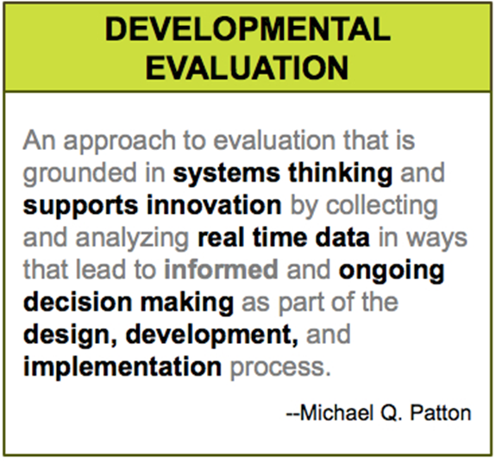
Program Evaluation paradigm:
Developmental Evaluation (DE)

Slide 32
Developmental Evaluation
Takes into account central ideas from complexity science (non-linearity, emergence, adaptation, uncertainty, dynamical system change, coevolution)
Tracks and attempts to make sense of what emerges under conditions of complexity, documenting and interpreting the dynamics, interactions, and interdependencies that occur as innovations unfold.
Useful for pre-formative development of potential scalable interventions.

Slide 33
Methodology for Developmental evaluation analysis
Research Question: What key decisions were made during the formative development of TAPESTRY and why?
Design of pilot: Sixteen week pilot study in older adults using sequential explanatory mixed methods approach and developmental evaluation methods.

Slide 34
Methods: Data collection
Catalogue of decisions :
Regular review of emails or other noted personal notes/thoughts/and reflections
Review of meeting minutes
Regular review of summary of decisions
Purposeful research team discussions

Slide 35
Data Analysis
1) what the decision was;
2) rationale for decision (ie what data justified decision);
  Persona group exercise (qualitative focus group)
  Implementation discussion groups / interviews
  Implementation data from surveys, narrative reports, research team processes
3) who was involved with the decision making; and
4) expected outcomes associated with the decision will be made (this will be to document changes that are made to the intervention as it is being implemented).

Slide 36
FINDINGS: Decisions to change the TAPESTRY approach
Major decision categories included:
  Patient Recruitment
  Surveys/Tools
  Privacy
  Volunteer visit
  Volunteer training
  My OSCAR/TAPESTRY App
  Interprofessional team

Slide 37
Selected Pilot Study Results

Slide 38
Pilot Study Research Design: Mixed Methods Sequential Explanatory
quantitative
QUALITATIVE
Experiences
Recruitment of patients
volunteer
patient
Interprofessional team
Community organizations
Research team
Recruitment of volunteers
Time taken
Patient goals chosen and progress
Data collection → analyses → interpretation
Data collection → analyses → interpretation
Two rounds at weeks 8 and week 16

Slide 39
Example Patient Profiles
Demographics | KEY ISSUES IDENTIFIED/ V-Notes
Male 71, lives alone, agitated with medical records | Uses > 5 different prescription medications; at times forgets to take prescription medications Cognitive concerns (abnormal clock test) Often or always coughs, chokes or have pain when swallowing food or fluids
Male 81, lives alone, sad, cried during visit | Very sad – loss of wife Nutrition score high risk; weight changed in the past 6 months without trying
Female 86, lives with daughter | Her balance not good with walker especially when bending over to pick up items on floor She fell in her apartment on November 3rd, trying to pick up something on the floor; a friend helped her to get up Uses 5 or more different prescription medications regularly
Female 77, lives alone, she has no children | None; expresses she does not have family support in the event her health declines (but is not concerned at this time).
Male 77, lives with wife (currently at St. Peter’s) | Has recently lost weight such that clothing has become looser Feels sad because of wife being in hospital

Slide 40
The Patient Experience
(Phase 1 results n= 10 reported here; an additional 19 patients have gone through phase 2 of the pilot since)
Home Visits:
  Total home visits by volunteers = 27
  Average number of visits per patient = 2.5
  Number of visits Cancelled = 2
  Average length of each visit = approx. 57 + 22 min
Alerts Generated:
  Total alerts generated = 13
    Nutritional deficiencies
    Inadequate physical activity
    Abnormal cognitive performance
    Elder abuse
    Taking medications incorrectly
    Want to talk about Advance Care Planning

Slide 41
The Patient Experience
(Phase 1 results n= 10 reported here; an additional 19 patients have gone through phase 2 of the pilot since)
The McMaster PHR:
  Number of Patients interested in McMaster PHR = 10
  Number of Patients trained for McMaster PHR = 10

Slide 42
Patient Goals…..
What Type of Goals Did our Patients Have for Themselves?
HEALTH-Related GOALS
Weight loss
Exercise/Active (4)
Nutrition/Diet (7)
LIFE-related GOALS
Read more often
Family connection
Keep driver’s license
Keep socially active (3)

Slide 43
Key Survey Findings
(N=10)
3/10 clients scored “apparently vulnerable” and 1 client scored “moderately frail” (EFS)
    3/10 clients had minor or other errors on the clock draw test (EFS)
3/10 clients identified “at risk” for nutrition (Screen II)
Majority (>70% of clients) self-reported “no problems” with their own general health (EQ5D)

Slide 44
Key survey Findings
(n=11)
5/11 (45%) would like to have a discussion with family physician about advance care planning
7/11 (64%) clients reported memory getting worse and 18% are worried about it.
7/11 (64%) have limitations with walking; 4/11(36%) have limitations with climbing stairs (MANTY)
4/11 (36%) scored sub optimal aerobic activity (RAPA)

Slide 45
Time needed to Complete Surveys
(TAP APP)

Slide 46
Next Steps
    RCT for in older adults 70+ (Jan 2015)
      McMaster FHT
      Design Delay Design (control & intervention groups will all get the intervention eventually)
      Primary Outcome: Goal Attainment
      Secondary Outcomes: self efficacy, social support, physical activity, patient centredness, QOL, and many, many more..
    2. Adaptation within Other Jurisdictions (Jan 2015)
      BC – Vancouver (UBC)
      SK - Sturgeon Lake First Nation (UofSK)
      AB/NL (UofA; Memorial)
      QC - Montreal (McGill)
    3. RCT for diabetes / hypertension group (April 2015)
    4. Other pilots (rural, high users of the health care system etc…Feb 2015)
    5. Many focused substudies ongoing / in development

Slide 47




Slide 48


www.healthtapestry.ca

